Slide 1

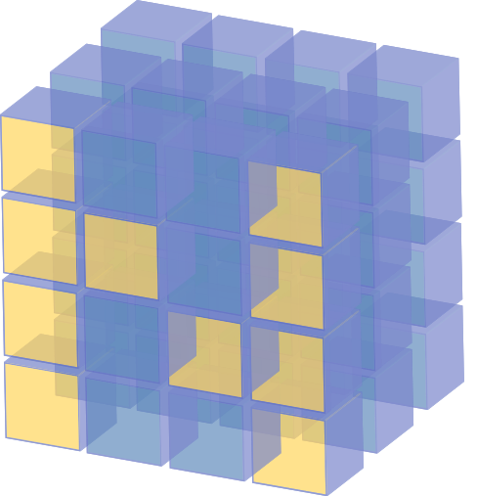
NumPy in Python
Lecture-10

Slide 2
Contents
Introduction
Creating arrays
Array Attributes
Array Operators
NumPy Methods
Shallow Copies
Deep Copies
sazzad@diucse

Slide 3
Introduction
NumPy (Numerical Python) is a python library used for working with Python arrays.
It offers a high-performance, richly functional n-dimensional array type called ndarray.
NumPy aims to provide an array object that is up to 50x faster that traditional Python lists.
Working domains: Linear algebra, and Matrices.
Over 450 Python libraries depend on NumPy.
Popular library: Pandas, SciPy, Keras (Deep Learning Library) depend on NumPy.
sazzad@diucse

Slide 4
Introduction
NumPy arrays support different data types.
NumPy vs. List
NumPy is faster than lists
NumPy data structures take up less space than lists
NumPy have better runtime behavior.
NumPy array need to be declared but lists don’t.
sazzad@diucse

Slide 5
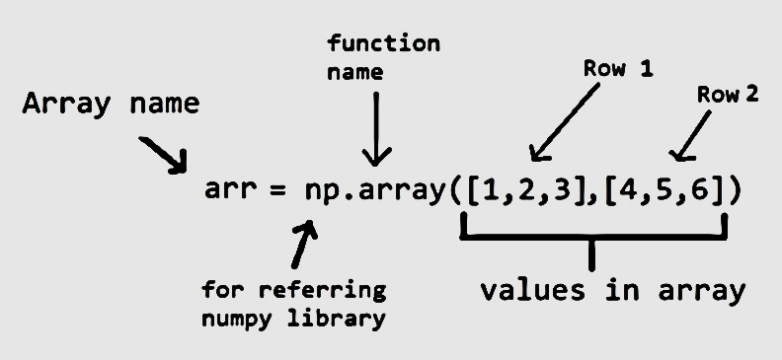
Creating arrays by Importing numpy
The NumPy documentation recommends importing the numpy module as np
The numpy module provides various functions for creating arrays.
The array() function, which receives an array as an argument.
NumPy separates each value from the next with a comma and a space and right-aligns all the values.
sazzad@diucse

Slide 6
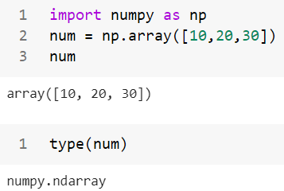
Creating arrays by Importing numpy
sazzad@diucse

Slide 7




Arrays with Multidimensional Arguments
The array function copies its argument’s dimensions.
NumPy auto-formats arrays, based on their number of dimensions, aligning the columns within each row.
1D array example:
2D array example:
3D array example:
sazzad@diucse

Slide 8

Creating arrays from Comprehension
Problem 1:
Create a two-dimensional array from a list comprehension that produces the even integers from 2 through 20 in the first row and the odd integers from 1 through 21 in the second row.
Solution:
Exercise:
Create a 2-by-5 array containing reverse order of the even integers from 2 through 10 in the first row and the odd integers from 1 through 9 in the second row.
sazzad@diucse

Slide 9
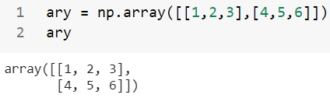


Array Attributes
An array object provides attributes that enable to discover information about its structure and contents. Some important attributes of this NumPy array are:
dtype:- The array function determines an array’s element type from its argument’s elements. For this NumPy array [[1,2,3], [4,5,6]], dtype will be int64.
ndim:- The attribute ndim contains an array’s number of dimensions. This 2-dimensional array [[1,2,3], [4,5,6]], value of ndim will be 2.
sazzad@diucse

Slide 10



Array Attributes
shape:- It contains a tuple specifying an array’s dimensions. Array [[1,2,3], [4,5,6]], value of shape will be (2,3).
size:- It can view an array’s total number of elements. for this 2-dimensional array [[1,2,3], [4,5,6]], size will be multiplication of 2 and 3 (Shape=(2,3)) 2*3 = 6.
itemsize:- the number of bytes required to store each element with itemsize. This NumPy array [[1,2,3], [4,5,6]], itemsize will be 8, because this array consists of integers and size of integer (in bytes) is 8 bytes.
sazzad@diucse

Slide 11
Array Operation
Operator | Equal Function | Operator | Equal Function
+ | np.add | > | np.greater
- | np.subtract | >= | np.greater_equal
* | np.multiply | < | np.less
/ | np.divide | <= | np.less_equal
// | np.floor_divide | == | np.equal
** | np.power | != | np.not_equal
% | np.mod
sazzad@diucse

Slide 12
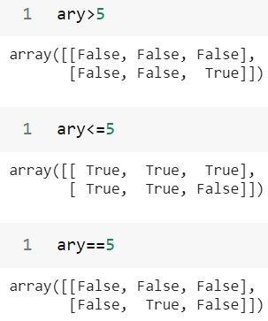
Array Operation
sazzad@diucse

Slide 13
NumPy Methods
An array has various methods that perform calculations using its contents. By default, these methods ignore the array’s shape and use all the elements in the calculations.
For example, calculating the mean of an array totals all of its elements regardless of its shape, then divides by the total number of elements.
Few NumPy default methods such as sum, min, max, mean, std (standard deviation) and var (variance).
Specifying axis=0 performs the mean calculation on all the row values within each column and axis=1 performs the mean calculation on all the column values within each individual row.
sazzad@diucse

Slide 14
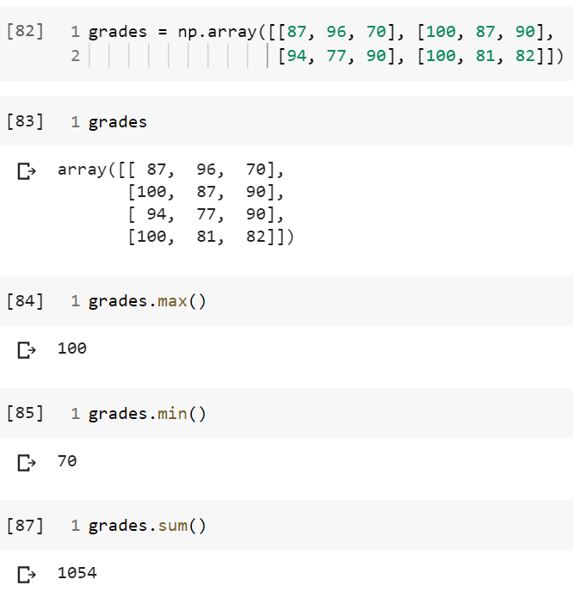
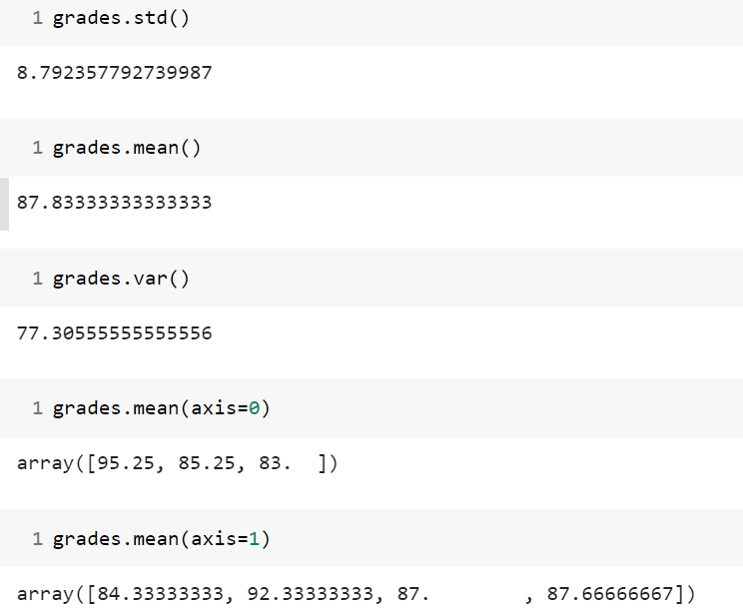
NumPy Methods
sazzad@diucse

Slide 15
Shallow Copies
A shallow copy means constructing a new collection object and then populating it with references to the child objects found in the original.
In case of shallow copy, a reference of object is copied in other object. It means that any changes made to a copy of object do reflect in the original object.
2
3
4
5
Array 1
Array 2
sazzad@diucse

Slide 16
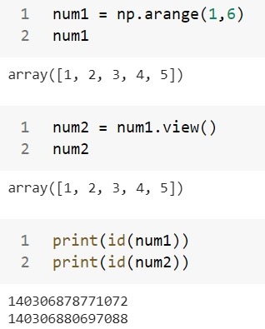
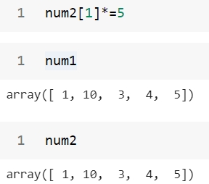
Shallow Copies
sazzad@diucse

Slide 17
Deep Copies
A deep copy constructs a new compound object and then, recursively, inserts copies into it of the objects found in the original.
In case of deep copy, a copy of object is copied in other object. It means that any changes made to a copy of object do not reflect in the original object.
2
2
3
3
4
4
5
5
Array 1
Array 2
sazzad@diucse

Slide 18
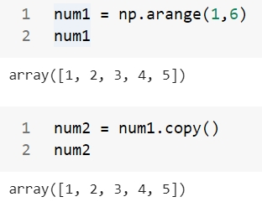
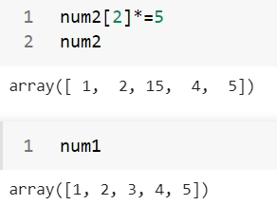
Deep Copies
sazzad@diucse

Slide 19
Thank You
sazzad@diucse

